Slide 1

Hands-on
Supervised classification of images

Slide 2

Jean-Philippe Moreux Bibliothèque nationale de France DSR/DCP, service Coopération numérique et Gallica Expert scientifique Gallica
Supervised classification of images
Hands-on
DHNord – novembre 2020

Slide 3
Plan
Images Classification with Watson Studio
Images Classification with Google AutoML
Images Classification with TensorFlow
Model test in Watson Studio
Local implementation with Python

Slide 4
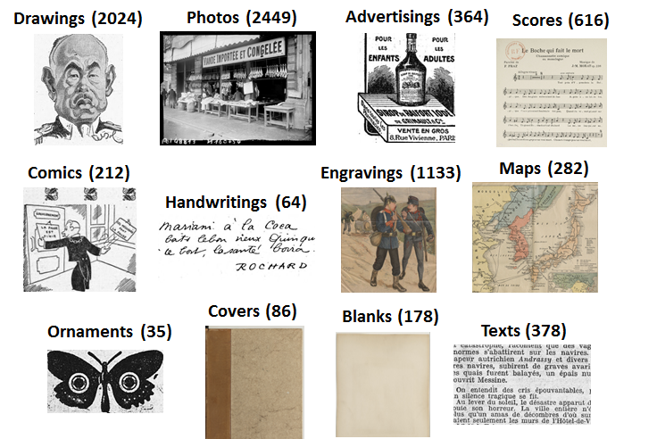
Classification with Watson Studio or Google AutoML
0. Create an IBM/Google account et then create a classification model project (see the setup document)
Define the images dataset (x images per class)
Train the classification model
Evaluate the model
Use the model:
in the IBM/Google cloud ecosystem
with Apple CoreML (IBM)
locally, with some code, using the APIs

Slide 5
Images Classification with Watson Studio
Model test in Watson Studio
Local implementation with Python

Slide 6
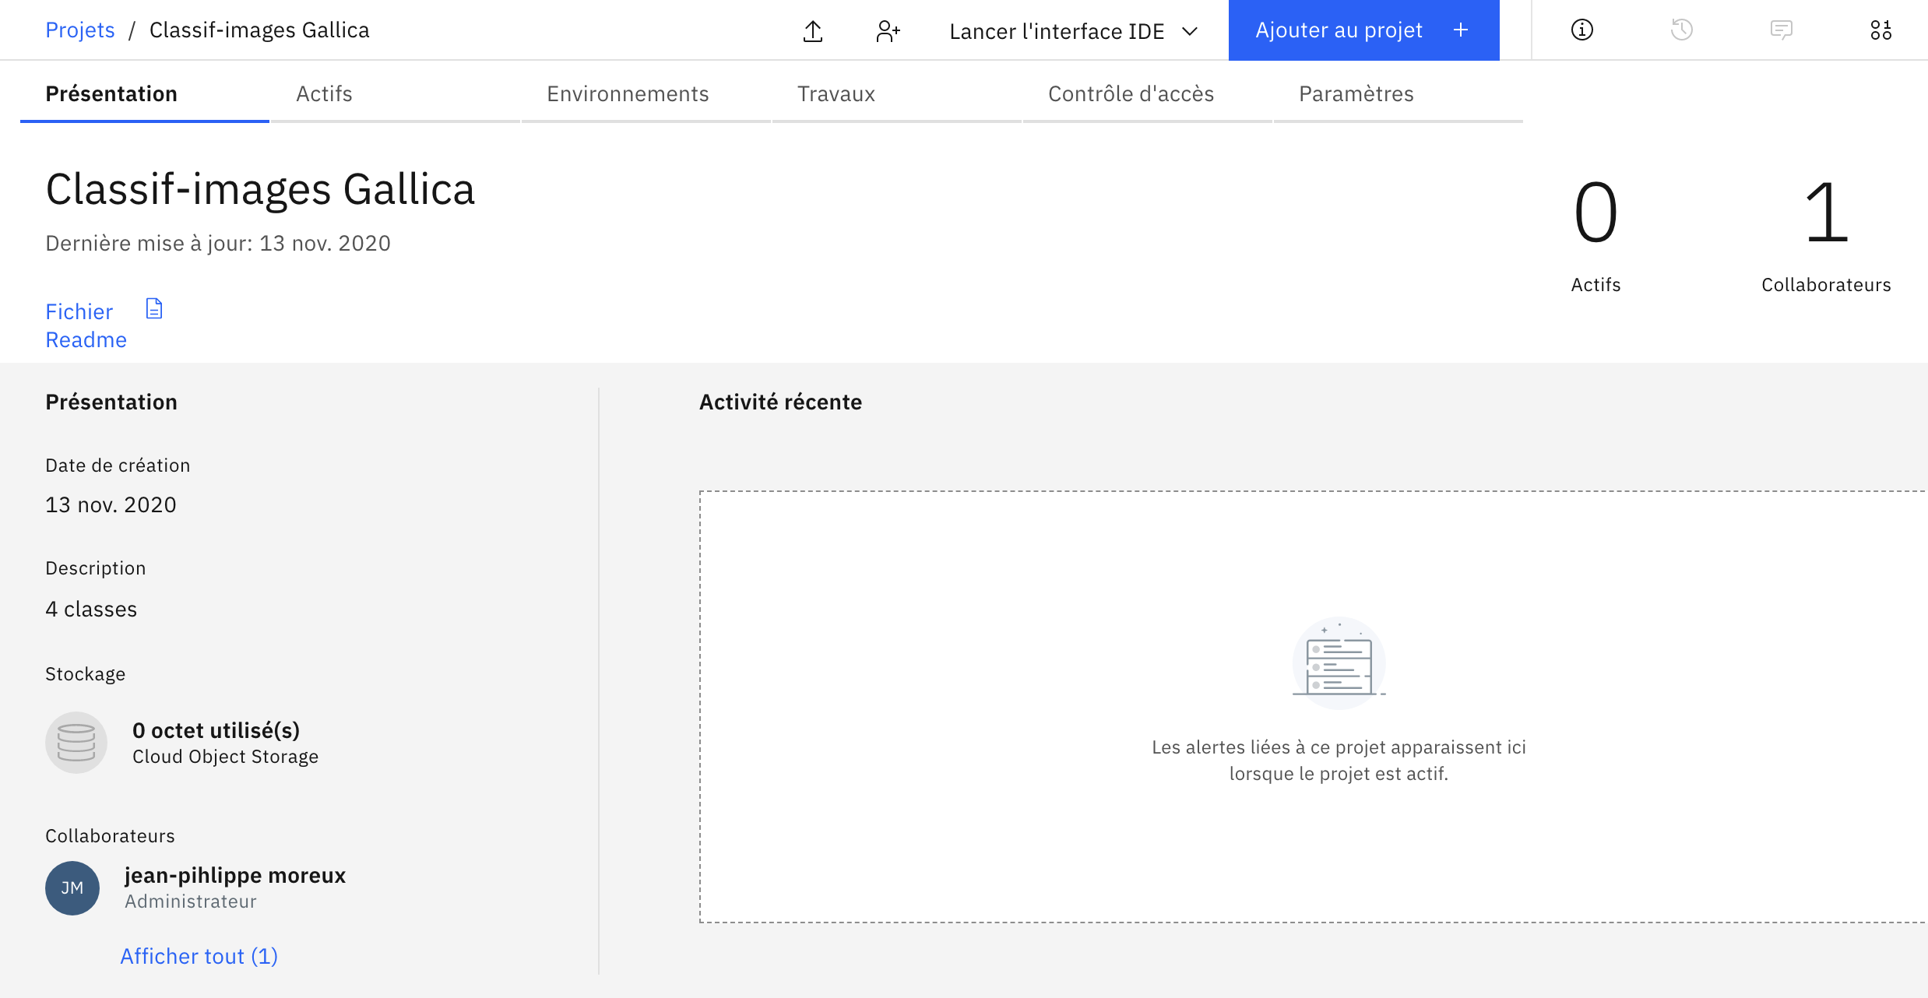
With IBM Watson Studio : project creation
Notes:
Compte : https://cloud.ibm.com/
jpmoreux@free.fr

Slide 7
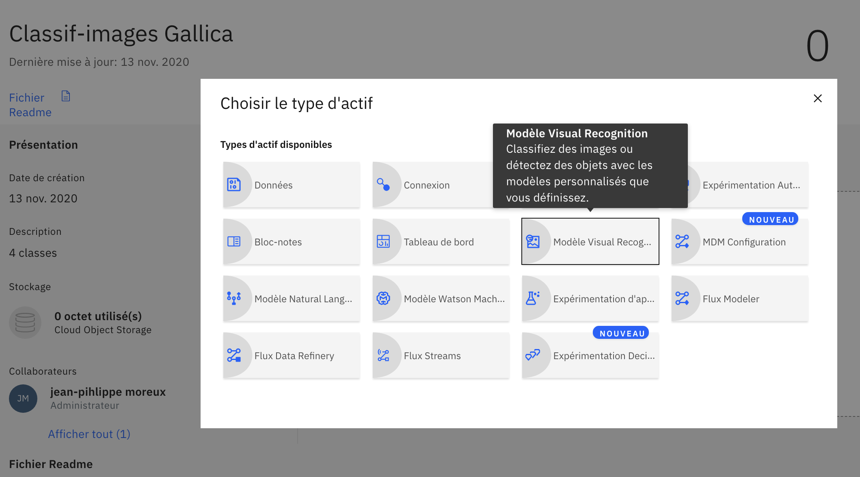
With IBM Watson Studio : add a resource
Visual Recognition
Notes:
Compte : jp.moreux@yahoo.fr
aller dans Services/Mes Services puis watson studio

Slide 8
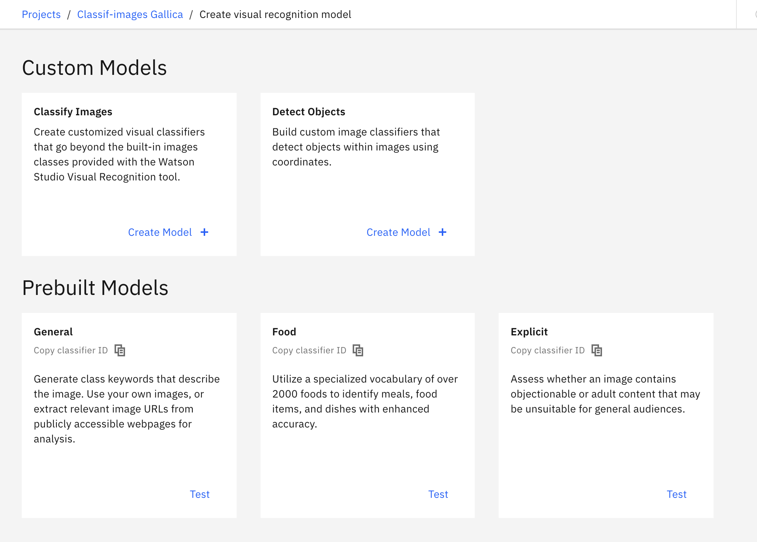
With IBM Watson Studio : classification models
Image classification
Notes:
Compte : jp.moreux@yahoo.fr
aller dans Services/Mes Services puis watson studio

Slide 9
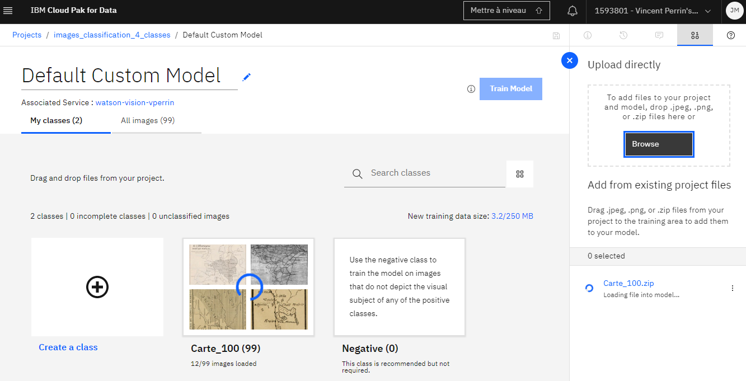
With IBM Watson Studio: uploading images
Classes: at least 10 images for Watson, one ZIP per class
Note: a classification model project must have been created first
See also: https://youtu.be/KIw_iac56Hc
Notes:
Compte : jp.moreux@yahoo.fr

Slide 10
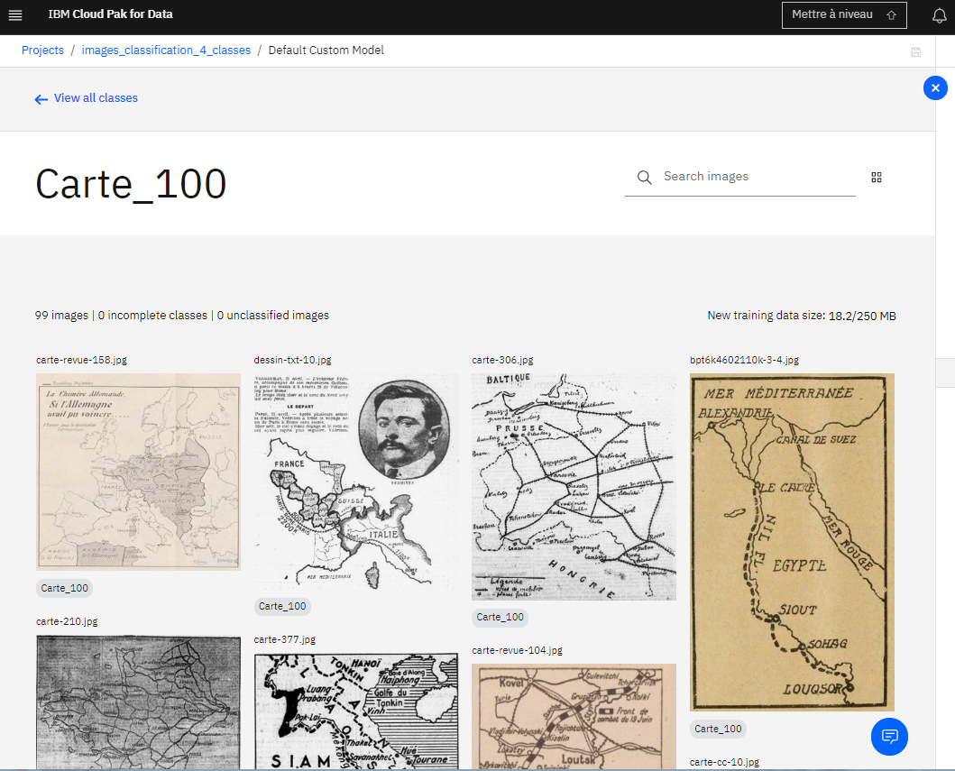
With IBM Watson Studio: classes definition
Notes:
Compte : jp.moreux@yahoo.fr

Slide 11
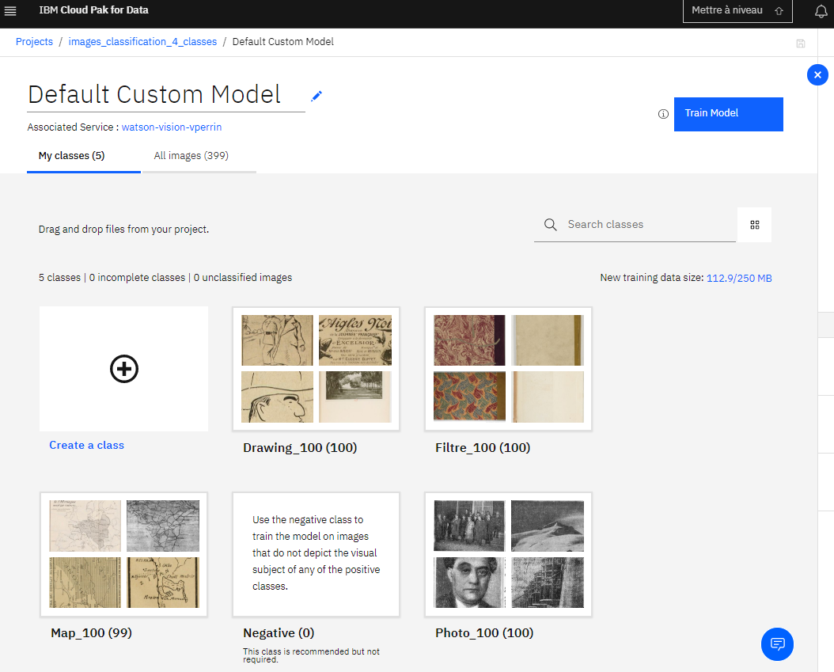
With IBM Watson Studio: training
Notes:
Compte : jp.moreux@yahoo.fr

Slide 12
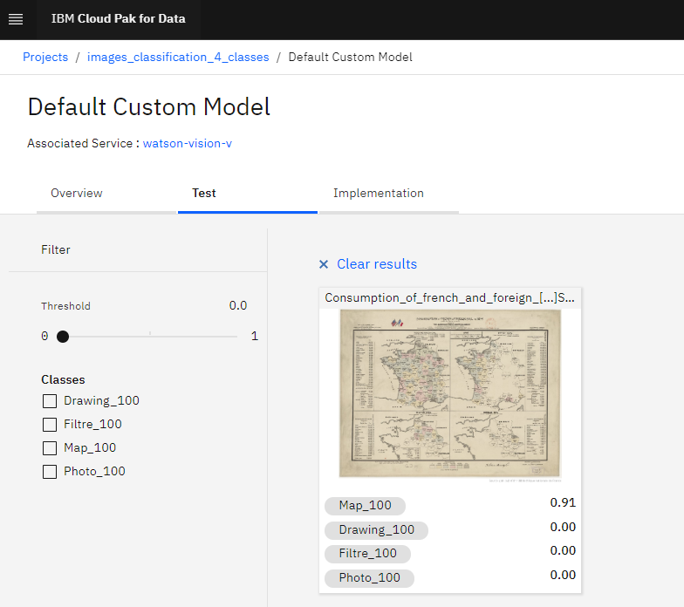
With IBM Watson Studio: model test
This illustration is a map (91% confidence)

Slide 13
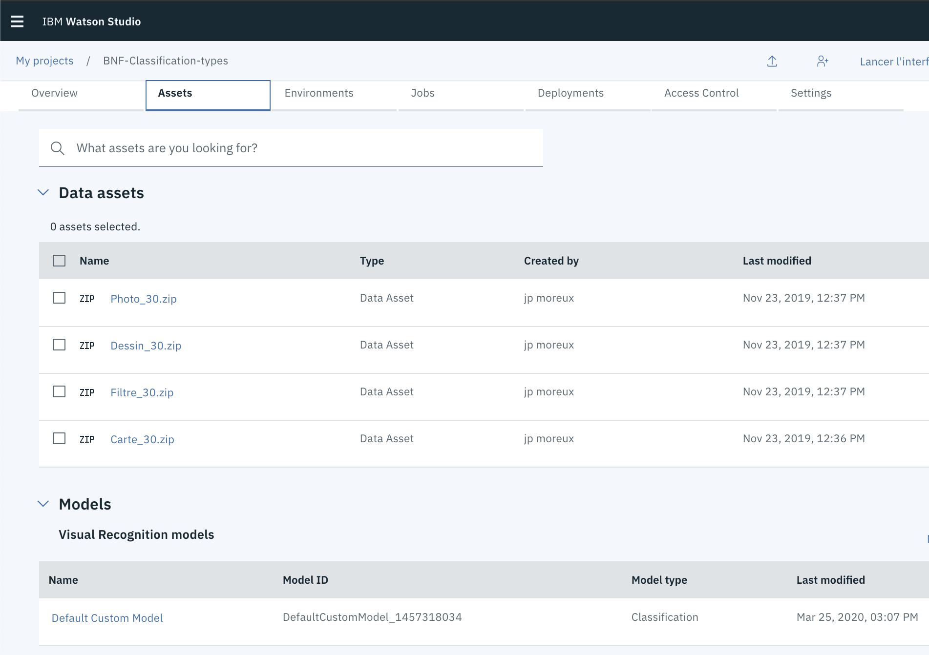
With IBM Watson Studio: using the model locally
Find the API key (see the appendix)
Find the model ID in the Assets tab, Models section
Click on the model to get the model ID

Slide 14
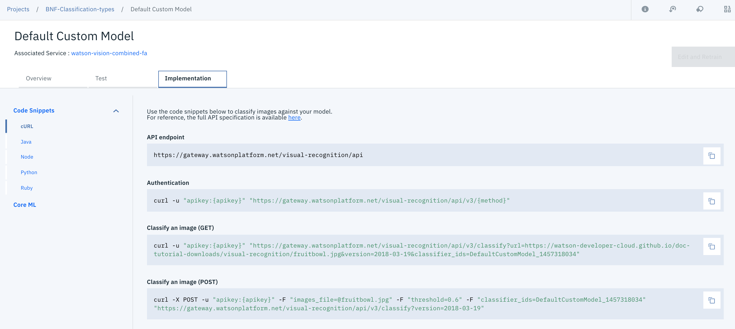
With IBM Watson Studio: using the model locally
4. Click on the Implementation tab: curl, Java, Python… examples are listed

Slide 15
With IBM Watson Studio: using the model locally
5. curl example as Terminal commands
To classify an image through its URL:
To classify a local image:
> curl -u "apikey:your_api_key" "https://gateway.watsonplatform.net/visual-recognition/api/v3/classify?url=your_URL&version=2018-03-19& classifier_ids=your_model_ID"
> curl -X POST -u "apikey:your_api_key" –F "images_file=@file_path" -F "classifier_ids=your_model_ID" "https://gateway.watsonplatform.net/visual-recognition/api/v3/classify?version=2018-03-19"

Slide 16

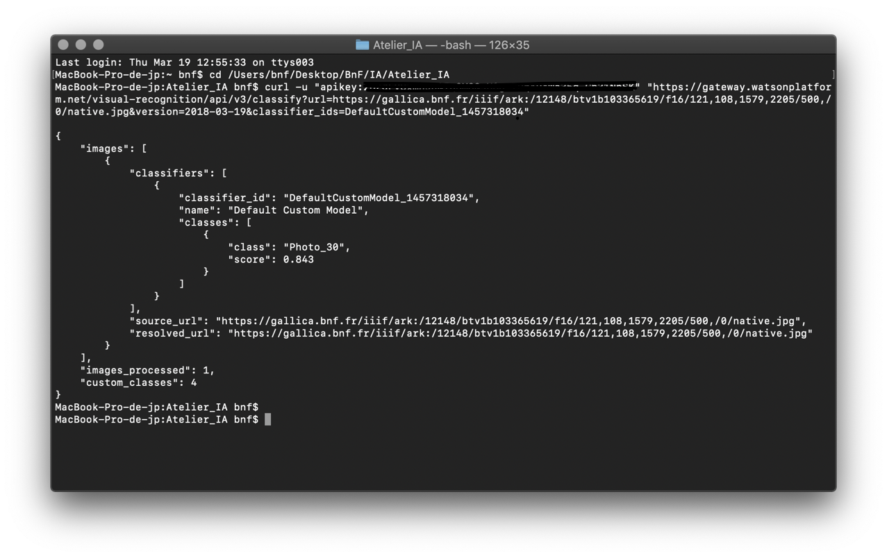
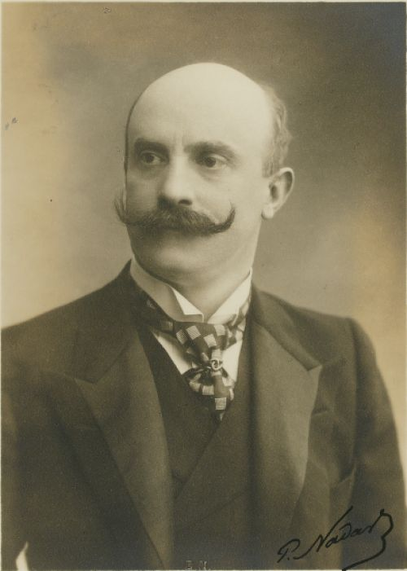
With IBM Watson Studio: using the model locally
Mac OSX example: classifying a IIIF Gallica image
See also the notebook
Result: « picture » class, confidence score = 0,843
https://gallica.bnf.fr/iiif/ark:/12148/btv1b103365619/f16/121,108,1579,2205/500,/0/native.jpg
Notes:
curl -X POST -u "apikey:" -F "images_file=@12148/bpt6k4628326j/f1.jpg" -F "classifier_ids=DefaultCustomModel_1457318034" "https://gateway.watsonplatform.net/visual-recognition/api/v3/classify?version=2018-03-19"

Slide 17
Images Classification with Google AutoML

Slide 18
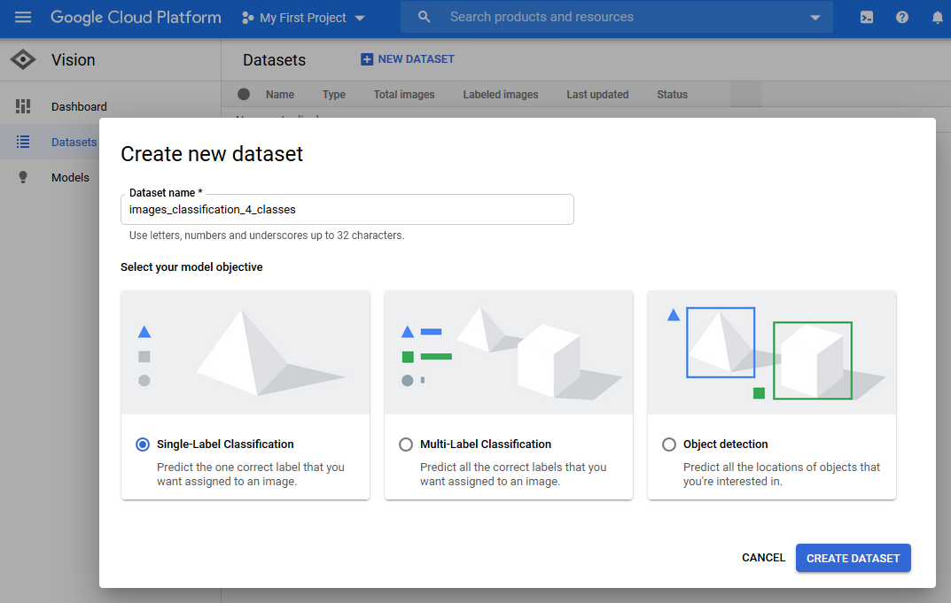
With Google Cloud/AutoML: uploading
Note: a classification model project must have been created first
See also: https://cloud.google.com/vision/automl/docs/beginners-guide
Notes:
Compte : jpmoreuxbnf@gmail.com

Slide 19
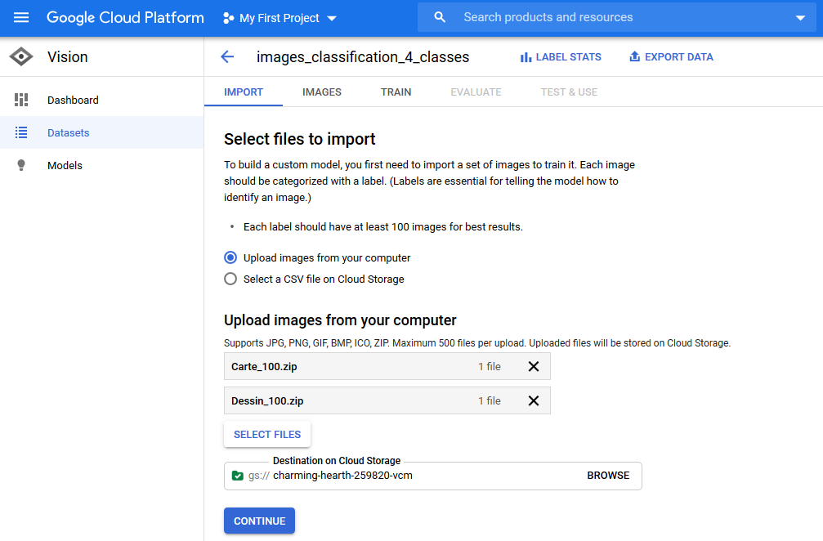
With Google Cloud/AutoML: uploading images
Select your .zip archives
Notes:
Compte : jpmoreuxbnf@gmail.com

Slide 20
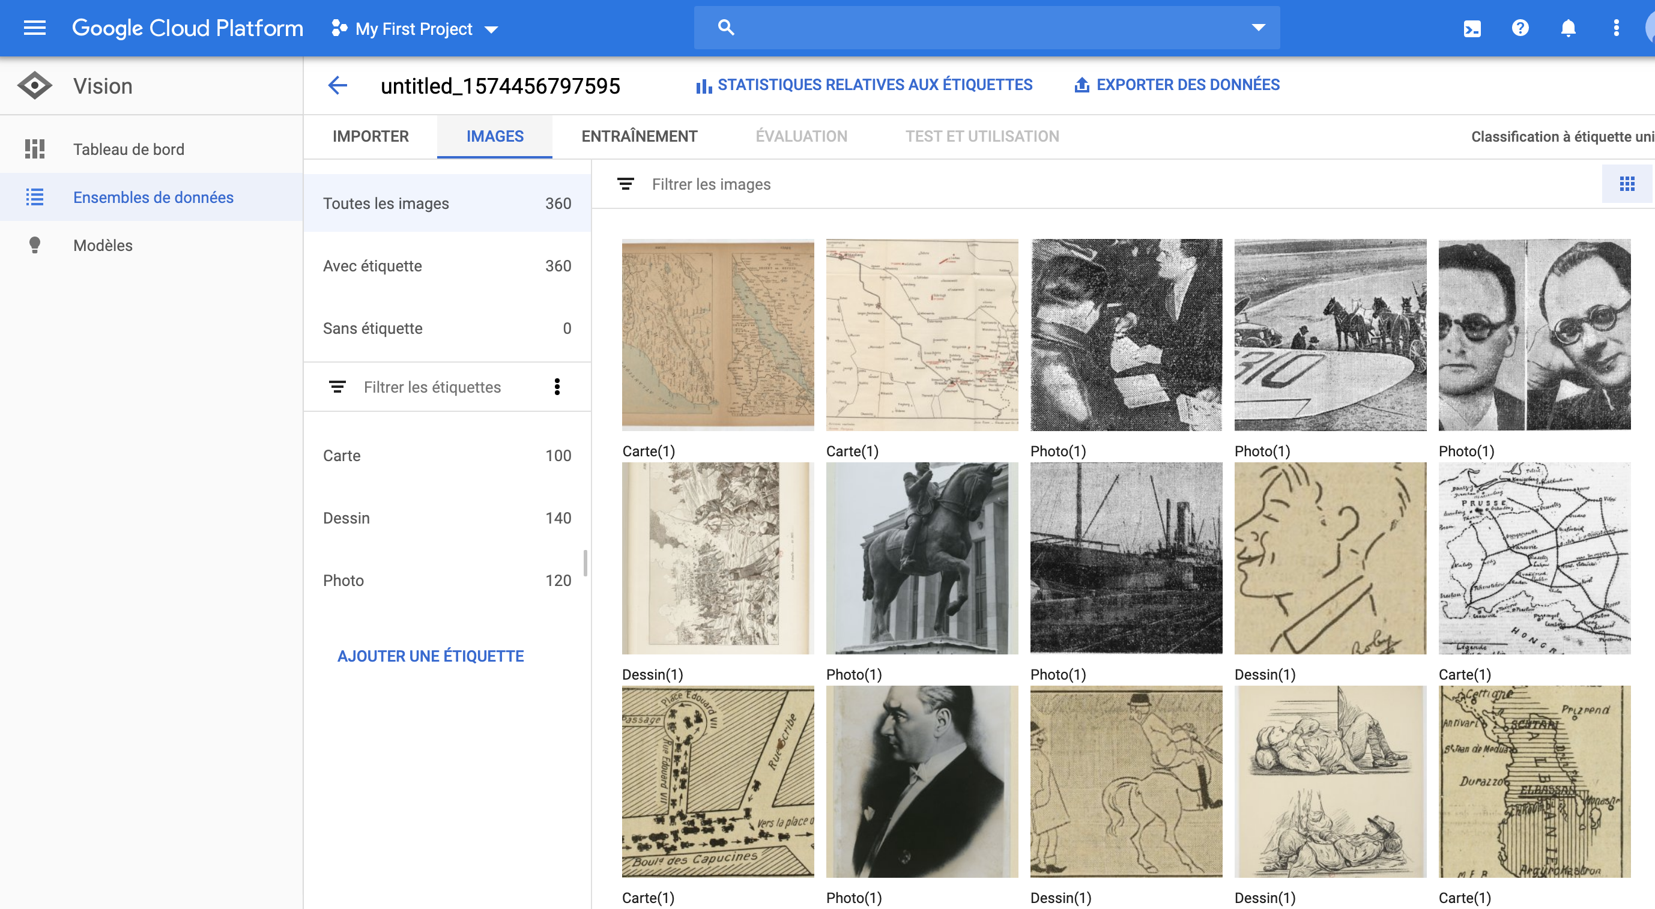
With Google Cloud/AutoML: classes definition
classes

Slide 21
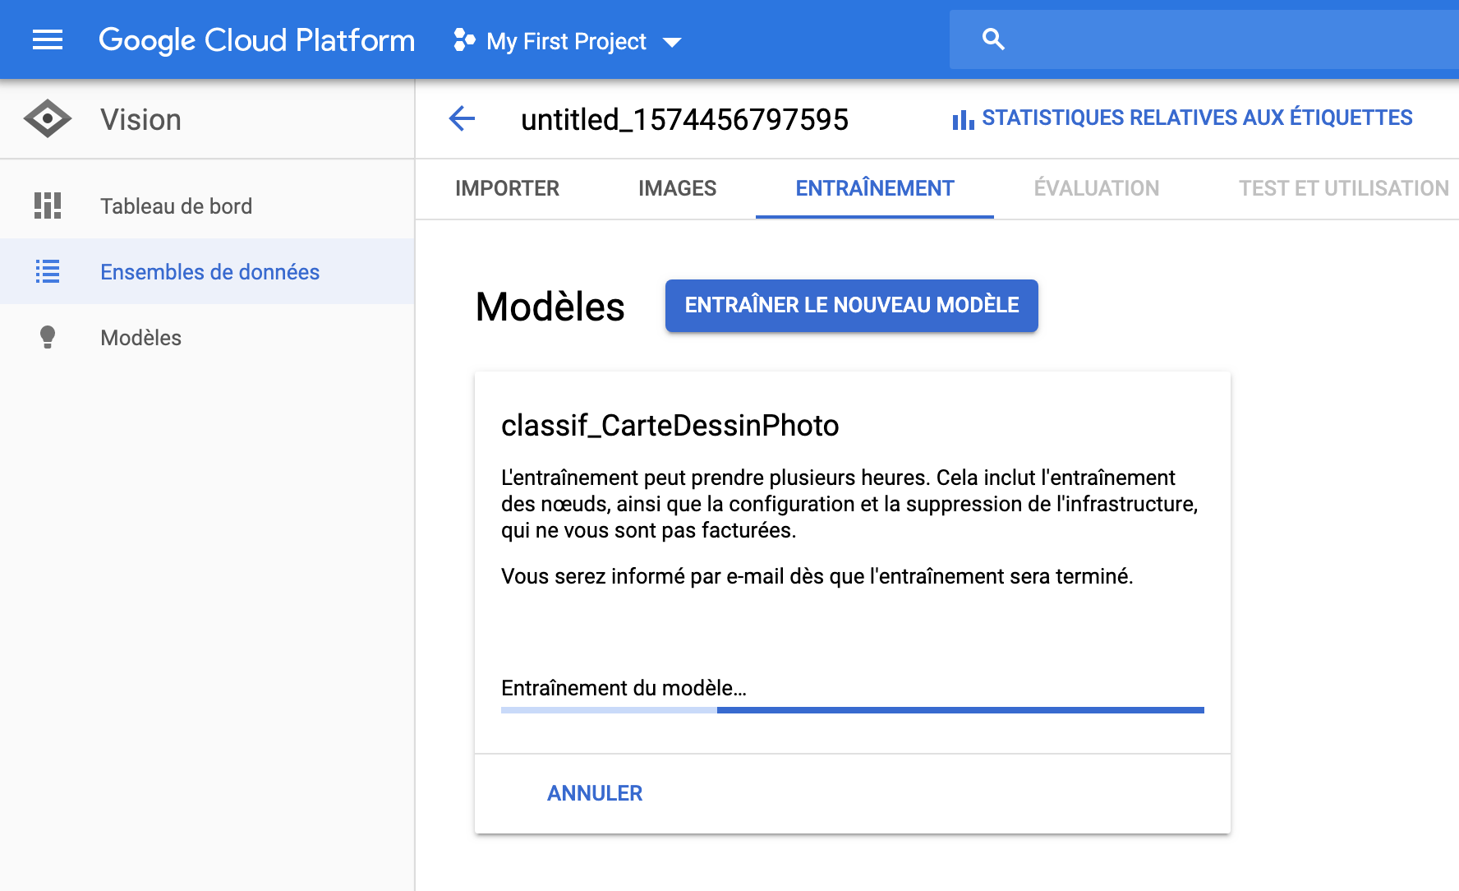
With Google Cloud/AutoML: training

Slide 22
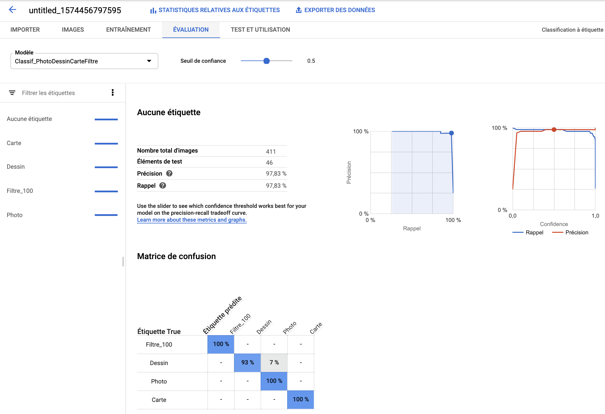
With Google Cloud/AutoML: model evaluation
confidence threshold
confusion matrix between classes
recall, accuracy
(and confidence)

Slide 23
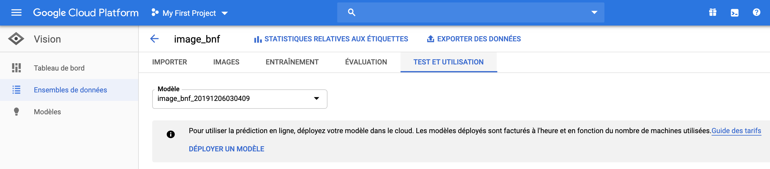
With Google Cloud/AutoML: model test
ATTENTION: you have to deploy the model first. Keep in mind to suppress it after testing, or you will be charged!

Slide 24
Images Classification with TensorFlow

Slide 25
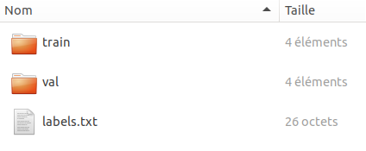
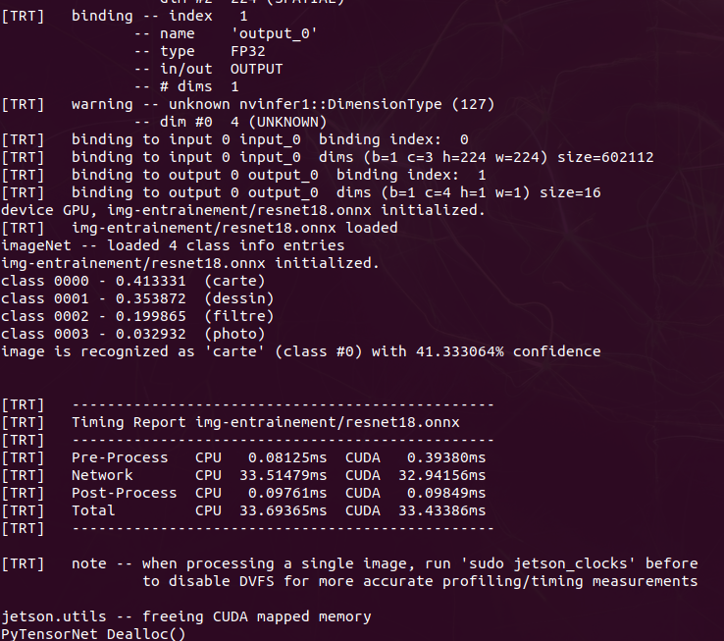
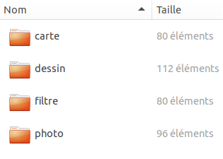
Classification with an AI framework
TensorFlow (Google), PyTorch (Facebook), CNTK (Microsoft), Caffe2, Keras…

Slide 26
Example with TensorFlow
Inception-v3 model is retrained on the images ground truth dataset, using a transfert learning method.
Three Python scripts (within the Tensorflow framework) are used to train (and evaluate) a local model:
split.py: the GT dataset is splitted in a training set (e.g. 2/3) and an evaluation set (1/3). The GT local dataset directory and the training/evaluation ratio must be defined in the script.
retrain.py: the training set is used to train the last layer of the Inception-v3 model. The training dataset path and the generated model path must be defined. The Inception model is downloaded from the retrain.py script.
label_image.py: the evaluation set is labeled by the model. The model path and the input images path must be defined.

Slide 27
Example with TensorFlow
To classify a set of images and output the results in a CSV file:
>python3 label_image.py > out.csv
Running the script outputs a line per classified image:
bd carte dessin filtrecouv filtretxt gravure photo foundClass realClass success imgTest
0.01 0.00 0.96 0.00 0.00 0.03 0.00 dessin OUT_img 0 btv1b10100491m-1-1.jpg
0.09 0.10 0.34 0.03 0.01 0.40 0.03 gravure OUT_img 0 btv1b10100495d-1-1.jpg
...
Each line describes the best classified class (according to its probability) and also the probability for all the other classes.

Slide 28
Appendix
Gallica images dataset
Howto: SaaS account creation
Howto: Access to the IBM API key

Slide 29
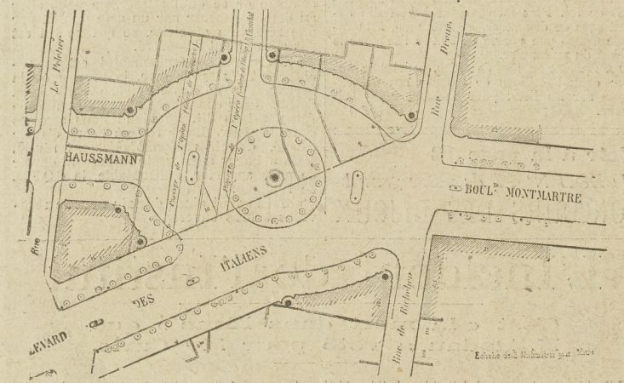
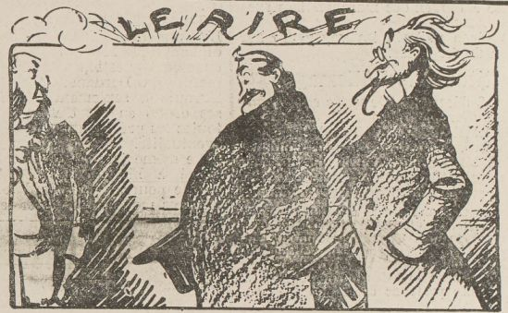

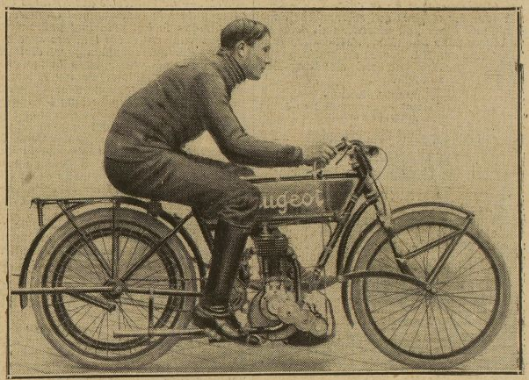
Gallica images dataset
Four classes (map, draving, picture, noise), 100 images per class
For Tensorflow:
Python script to split the dataset in training/test parts
Classes list (.txt file)
See also api.bnf.fr for more datasets

Slide 30
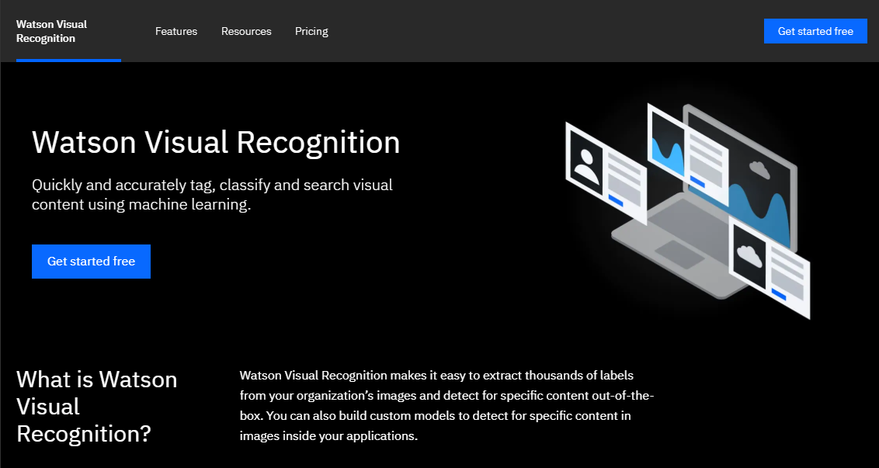
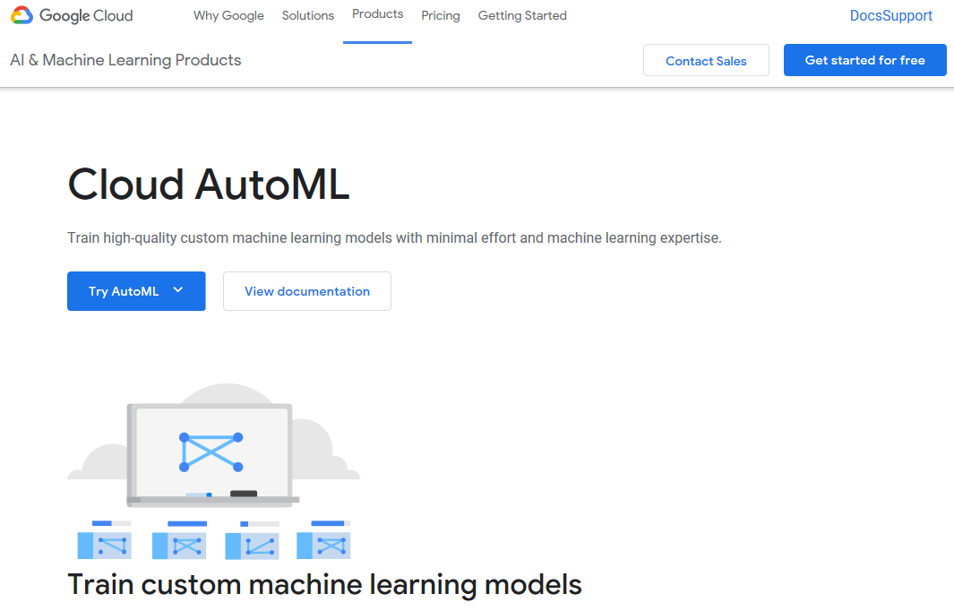
Howto: SaaS account creation
To create IBM Watson Studio or Google AutoML accounts, see the setup_Watson-AutoML_EN howto

Slide 31
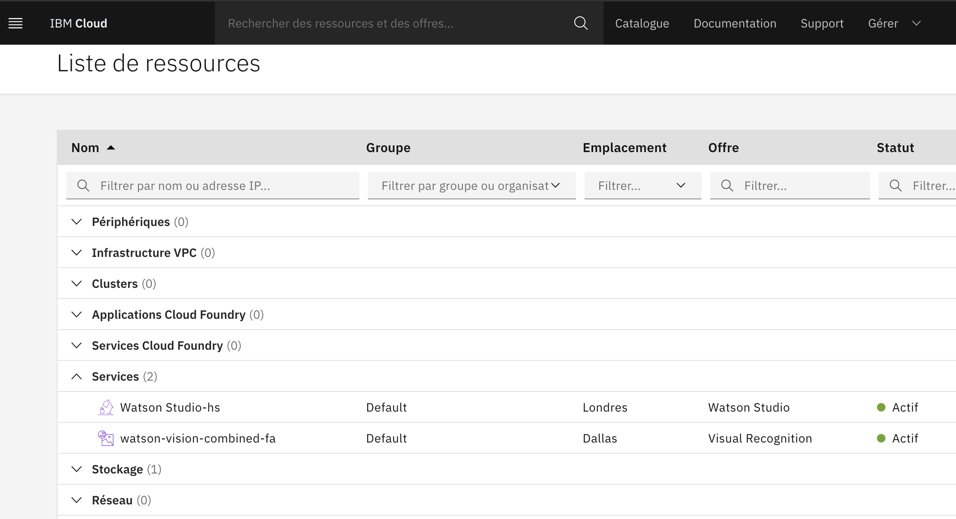
Howto: access to the IBM API key
Go to https://cloud.ibm.com/resources
Select the Watson-Studio service

Slide 32
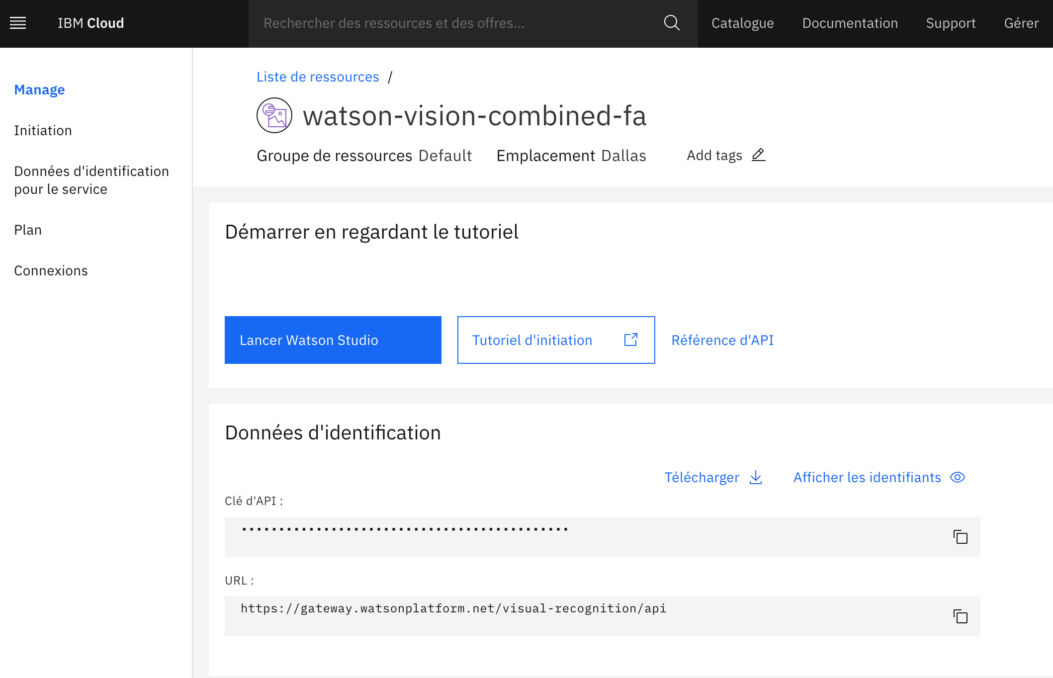
Howto: access to the IBM API key
The key is displayed in the Manage tab
Download or copy the key

